Slide 1
Final Presentation
Cyan: Minwoo Kim, Hyeonseo Park, Jongwon Lee

Slide 2
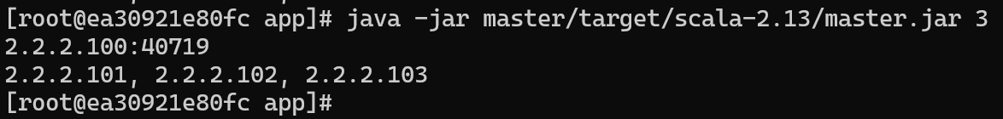
Program Specification
output file: one completely sorted file named partition.n, n is order of worker program
sort correctness check passed by test code (shell program)
complete fault tolerance on one worker one fault scenario
logger applied: log at worker.log(master.log) with timestamp, classname, log level, message
almost no assumption or easy modification on physical memory, file size

Slide 3
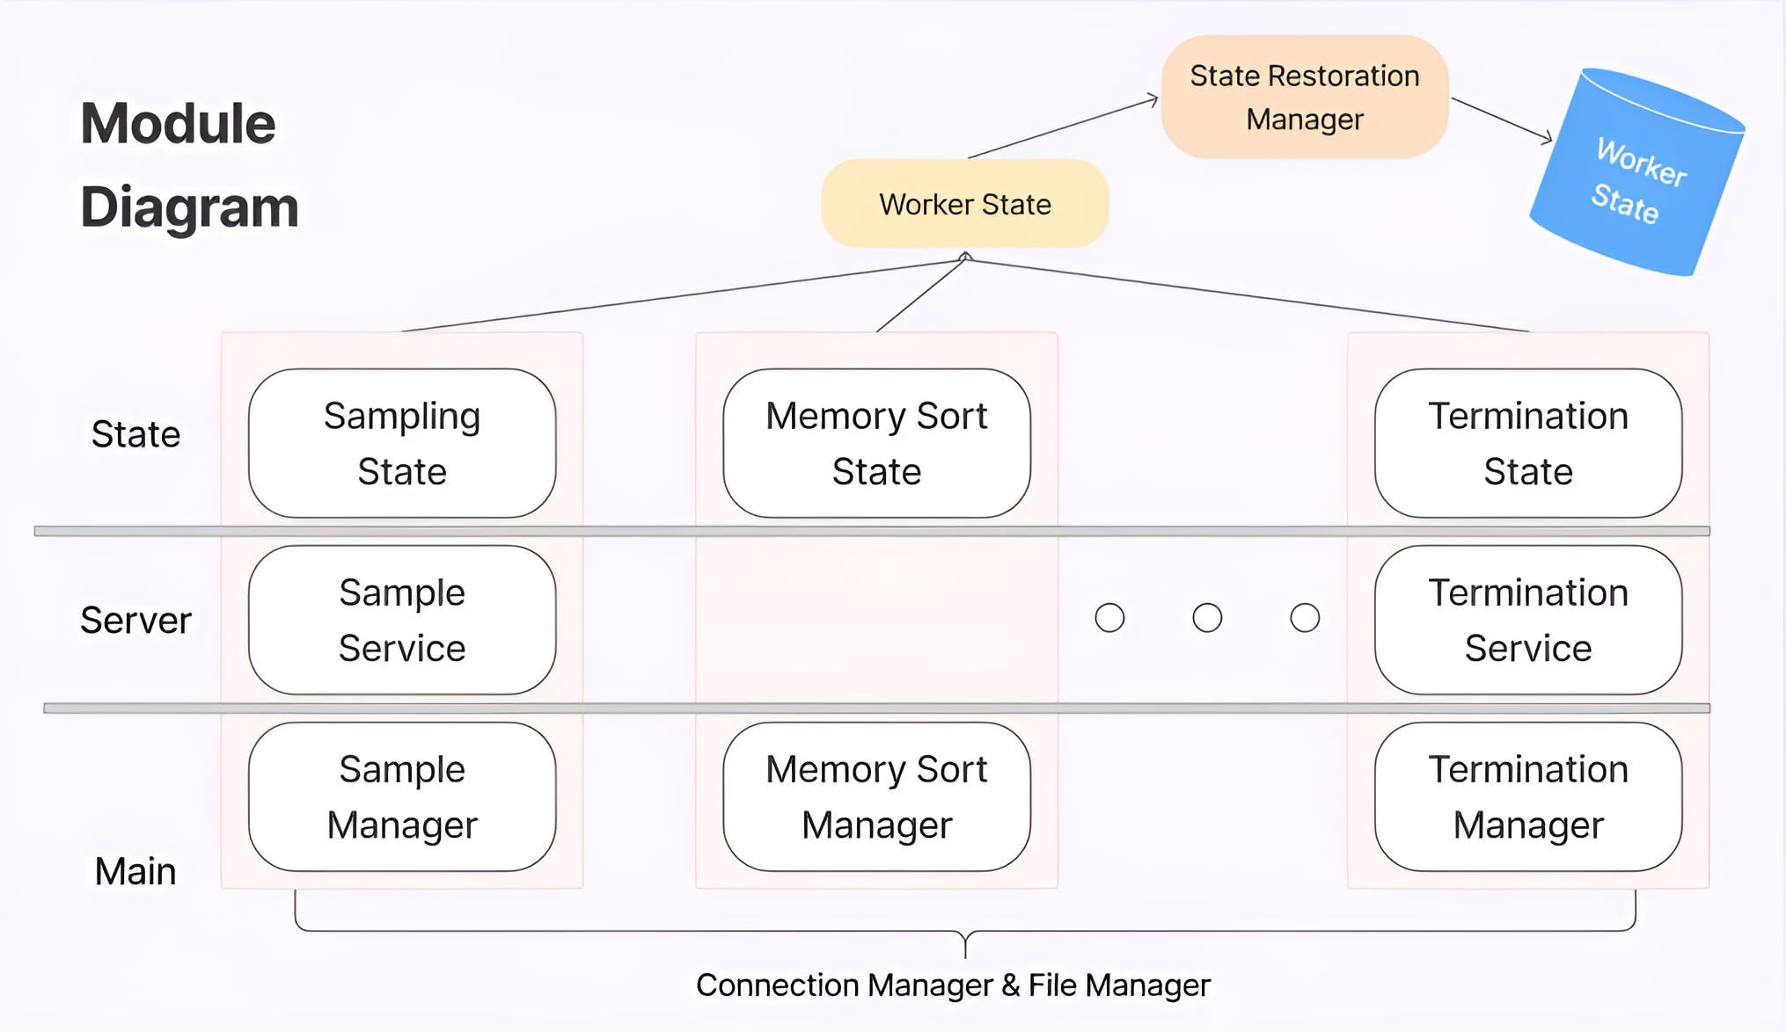

Slide 4
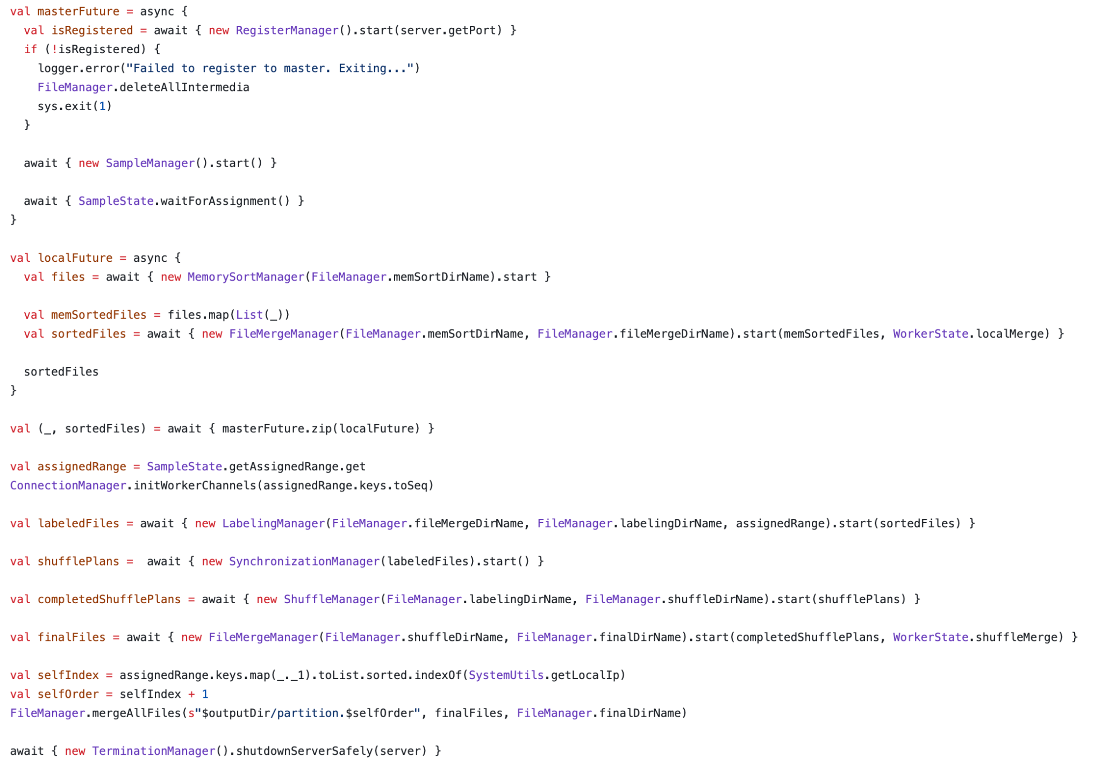
explicitly call each phase
reuse merge phase code
represents concurrent phases

Slide 5
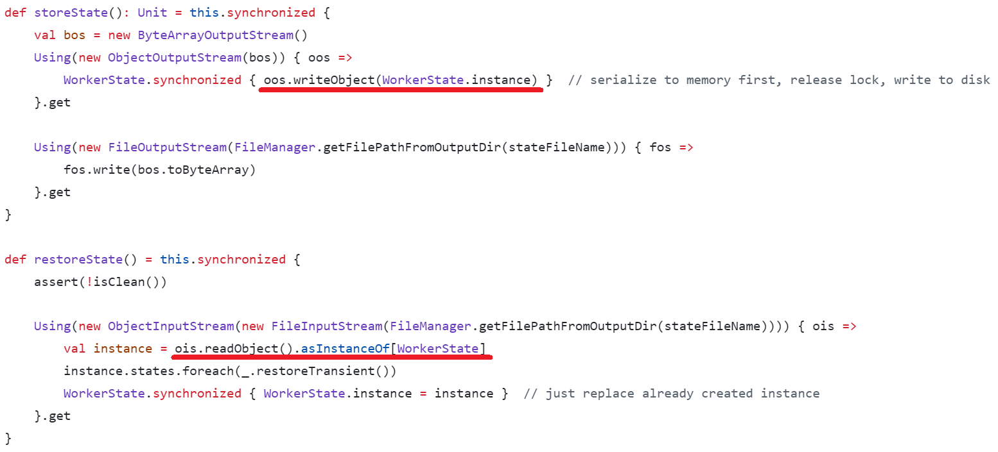
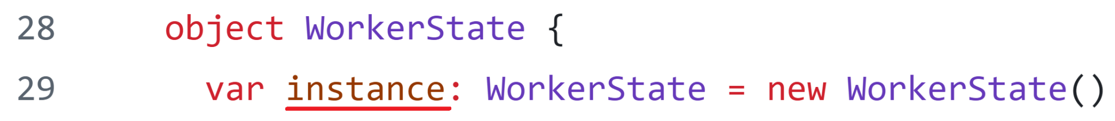
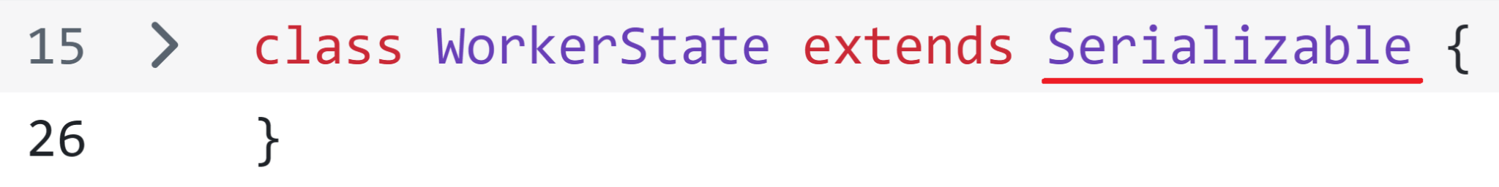
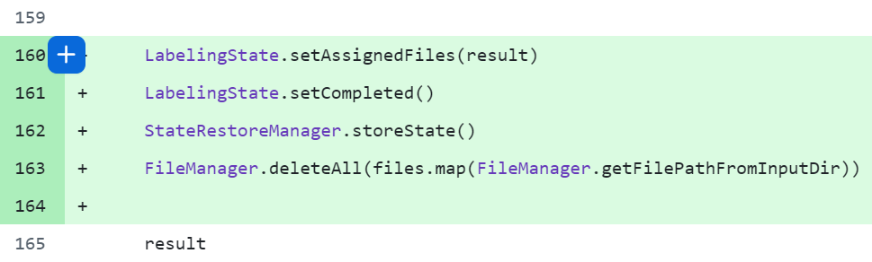
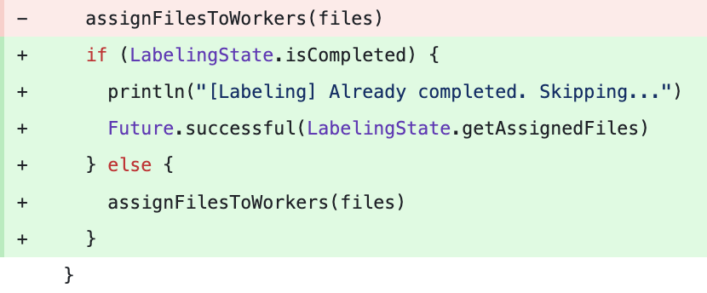
State Restoration
writeObject -> disk -> readObject
use global & serializable state
change state and call storeState()
when restored, just check state and skip

Slide 6
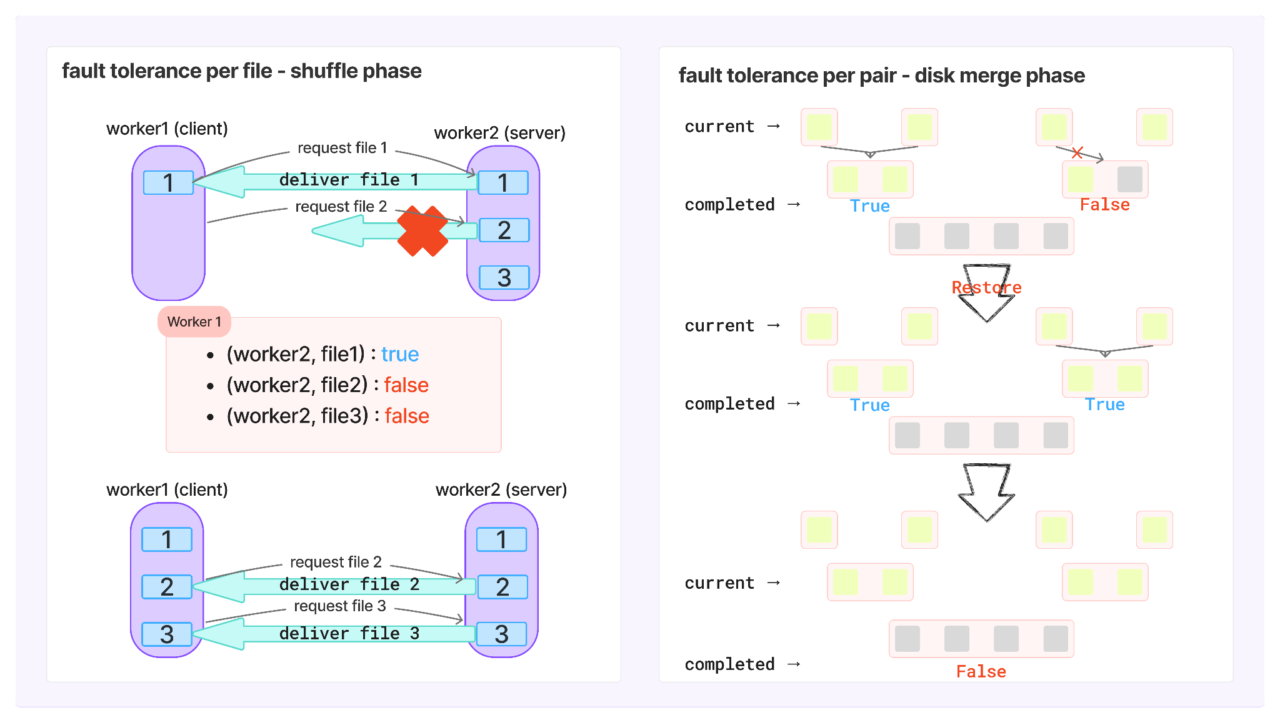

Slide 7
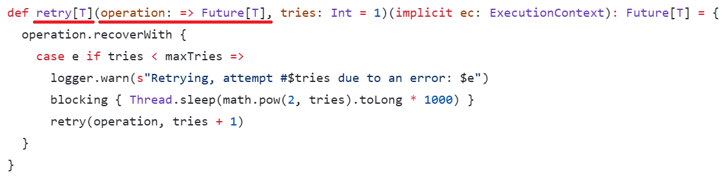

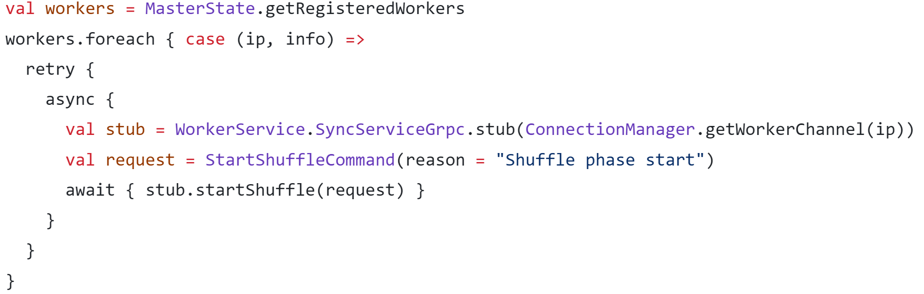
Client action on Server dies
RetryUtil: retry until server revives
use call-by-name to create future
shuffle:
sync:

Slide 8
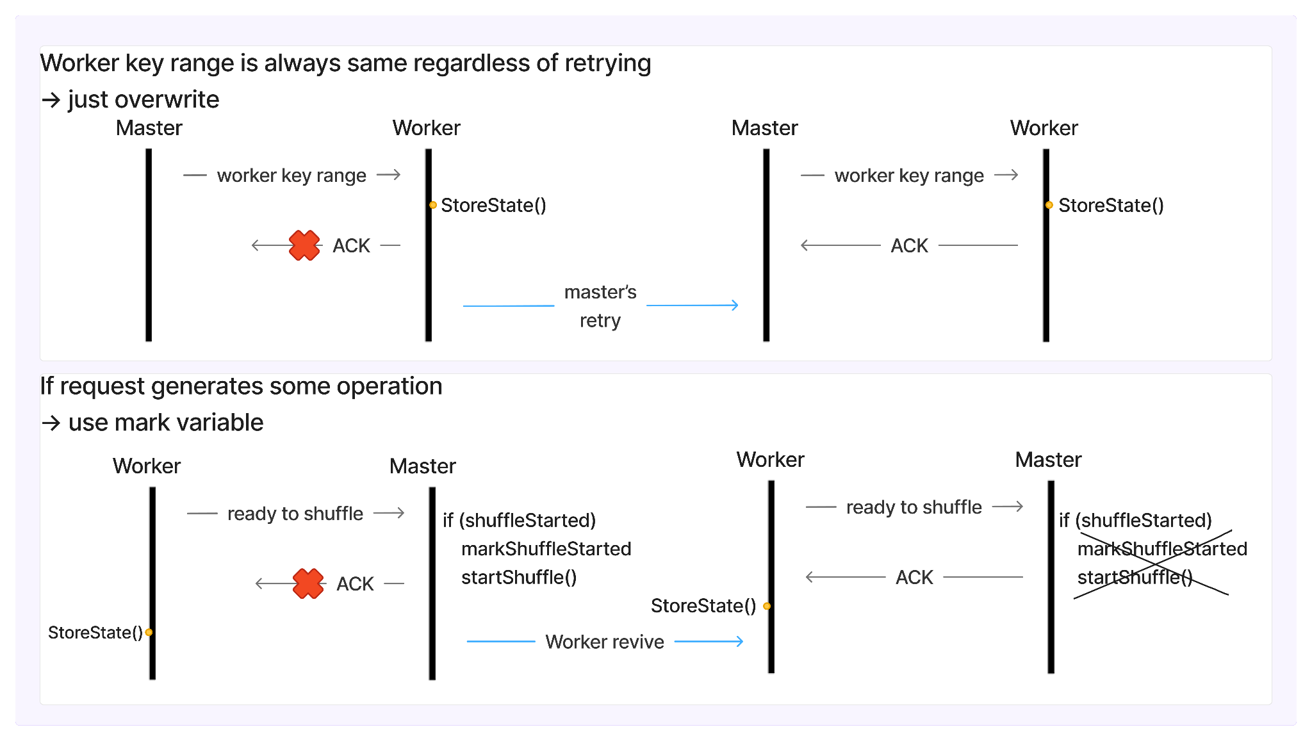
All cases considered for fault tolerance
Impossible to do every operation atomically with storeState()
-> two main strategy: 1. overwrite, 2. mark

Slide 9
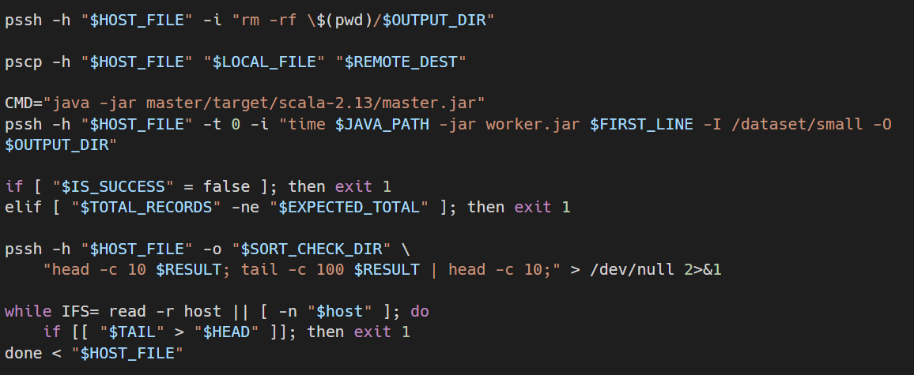
Test Automation Shell Script
automate execution of master and worker
each worker has one sorted file -> valsort passed
fault tolerance test passed
ctrl-c while program is running
kill worker at specific phase by sys.exit
use normal version of jar file when revives
all worker’s record sum: input == output
previous worker’s tail <= current worker’s head

Slide 10
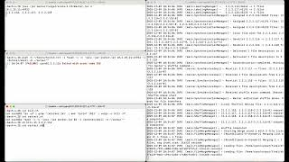
Result
Execution time on 5 workers
small : ~6 seconds
big : ~22 seconds
(assigned test & demo time was not enough to test large)
Optimization methods:
parallel execution on sort & merge
increase disk buffer to reduce io
use disk lock to reduce disk thrashing
increase chunk size on network stream
demo for /dataset/small on 3 workers
kill worker once.

Slide 11
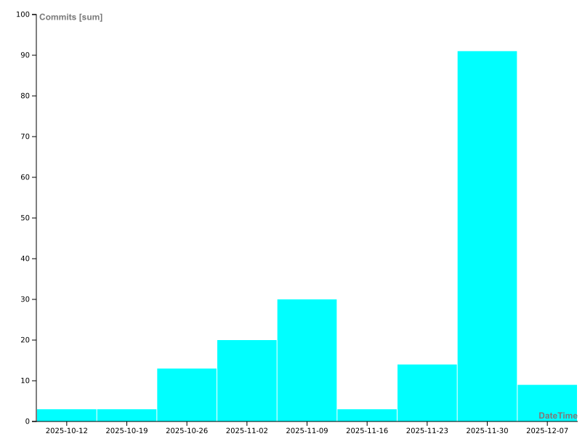
Communication
Code Review was not trivial work
week6~7 was almost dedicated for review of core features
total comment number (including ai review): 1148 comments..
Distribution of work was not that ideal
work speed: face to face > remote on same time > fully distributed
commit graph by time
(implemented earlier, but merged later to main)

